Slide 1


Supermarket Sales and Customer Behavior Analysis
Project-200-team
Pratik Gautam, Bishesh Raut, Kashish Tiwari

Slide 2
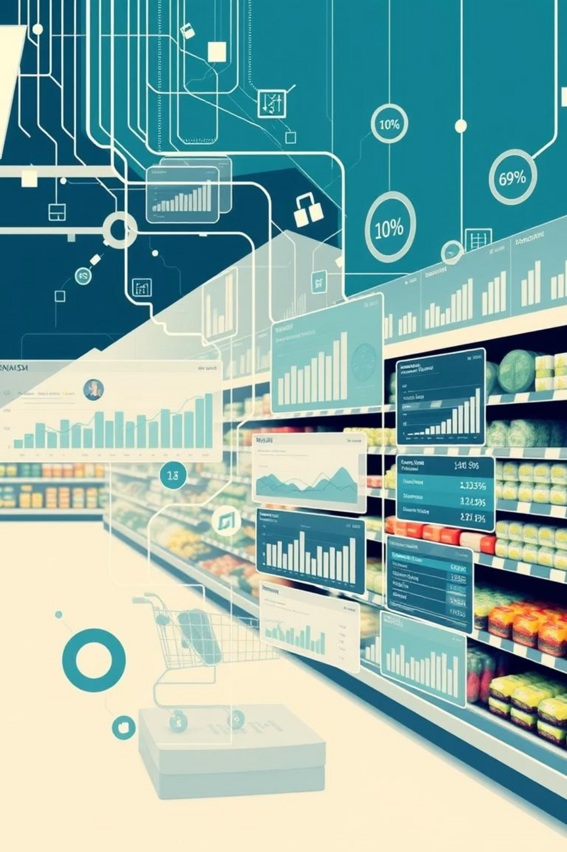
Project Overview
Problem Statement
Predict and improve profit through transaction data analysis.
Key Goals
Assess feature impact :
Branch, Discount, Customer Type on profit.
Predict most profitable categories.

Slide 3
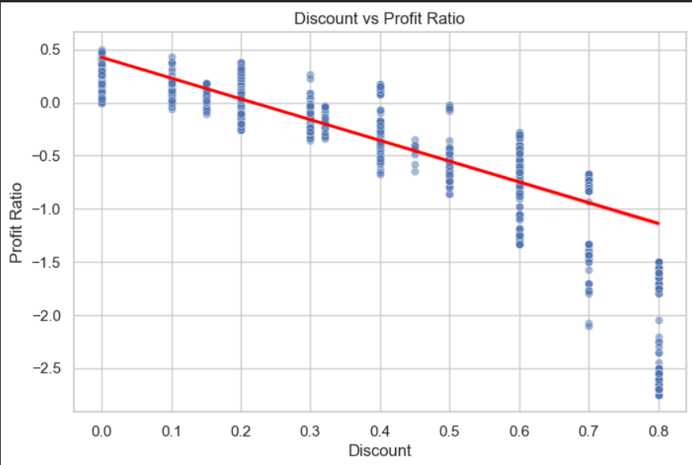
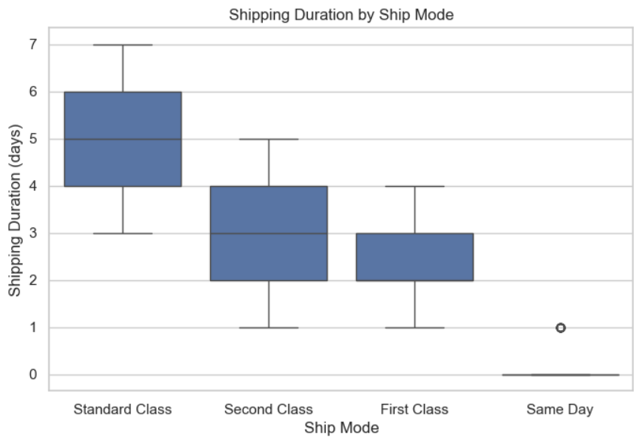
Data Analysis (Week 3)
No missing values detected in the dataset.
Ensured data completeness for analysis.

Slide 4
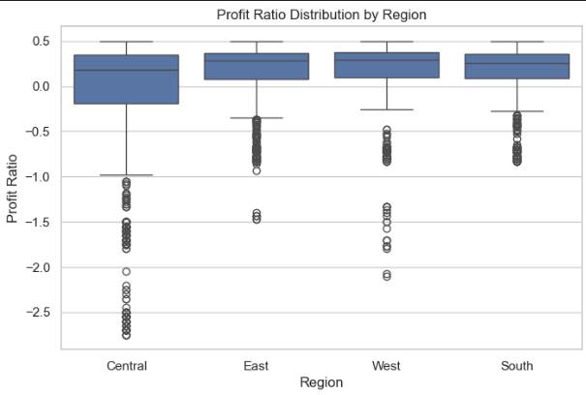

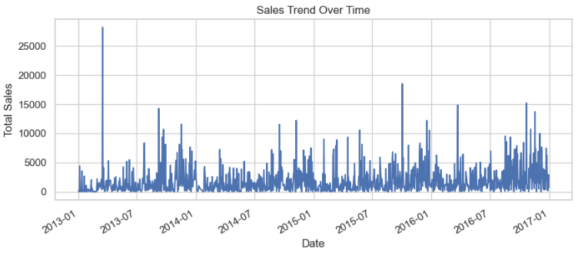


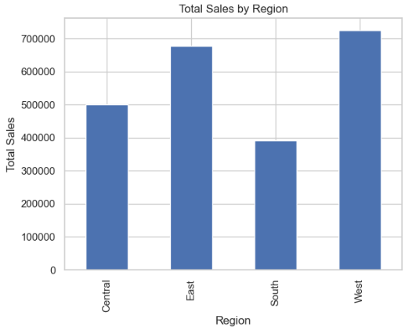
Data Preprocessing
Data Types
Converted dates and categorical variables.
Outlier Detection
Identified and handled extreme values effectively.
Feature Encoding
Encoded Region, Ship Mode, and other variables.

Slide 5




Literature Support
Kumar et al. (2020)
Smith & Lee (2019)
Customer loyalty using POS data insights.
Help understand and predict customer purchase behavior.
Random Forest and XGBoost for sales prediction.
Helps with advanced models in enhancing sales forecasting accuracy
Gonzalez & Rahman (2018)
Promotions and store layout influence on sales.

Slide 6
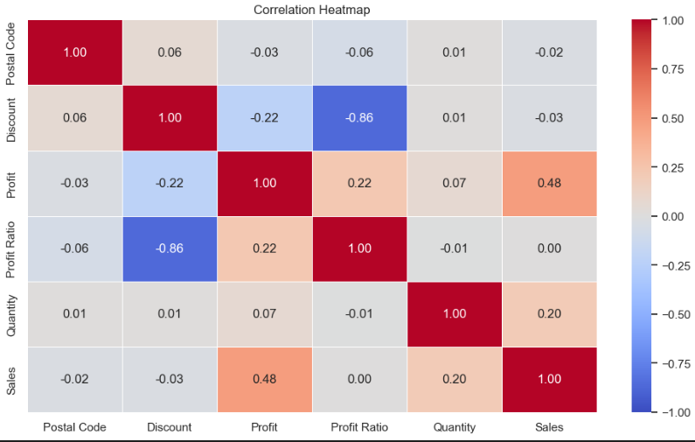
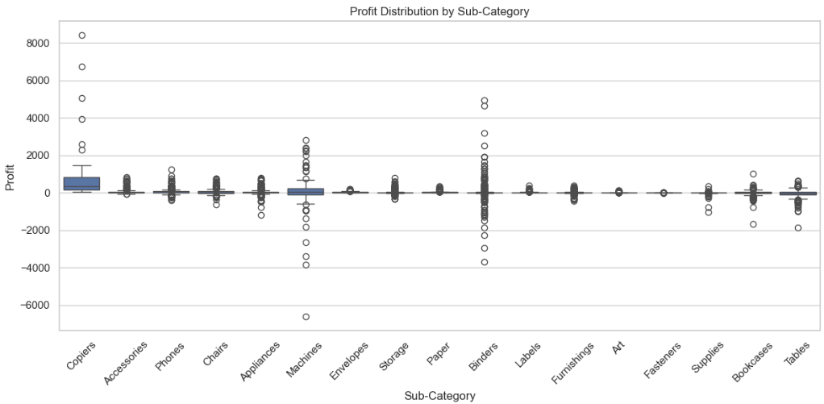
Feature Relationships
Correlation Heatmap
Categorical Patterns
Sales vs. Profit: Explored direct relationships.
Analyzed trends within Category and Sub-category.
Discount vs. Profit: Observed negative correlation.
Revealed specific product type impacts.

Slide 7
Model Selection & Hypotheses (Week 4)
Selected Models
Key Hypotheses
Linear Regression: For continuous profit prediction.
Higher discount negatively impacts profit.
ANOVA: To compare regional and category differences.
Profit varies significantly across regions.
Certain product sub-categories are expected to consistently yield high profits. Investigated with ANOVA.

Slide 8






Statistical Analysis & Validation
ANOVA Results
P-values across sub-categories confirmed significance.
Regression Summary
R² score and coefficient analysis for predictive power.
Logistic Regression
Correlation heatmap validated classification accuracy.

Slide 9
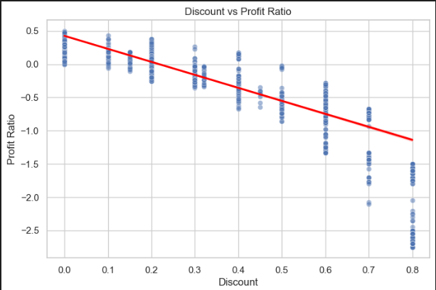
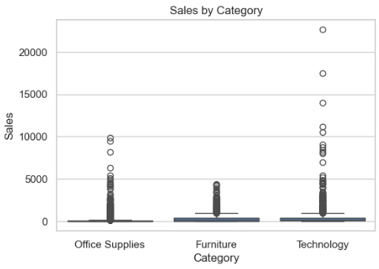
Final Insights & Discussion
Profitability Leaders
Identified top-performing product types and regions.
Discount Impact
Determined thresholds leading to profit reduction.
Behavior Drivers
Uncovered key factors influencing customer purchasing.

Slide 10
Python Application
Libraries Utilized
Application Description
pandas for data manipulation.
Interactive dashboard for profit predictions and EDA.
matplotlib for visualizations.
Developed using Python.
sklearn for machine learning models.
tkinter/streamlit for user interface.

Slide 11
Application Demo
Demo link:http://localhost:8501

